Slide 1
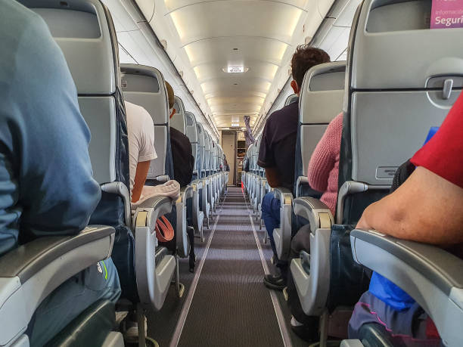
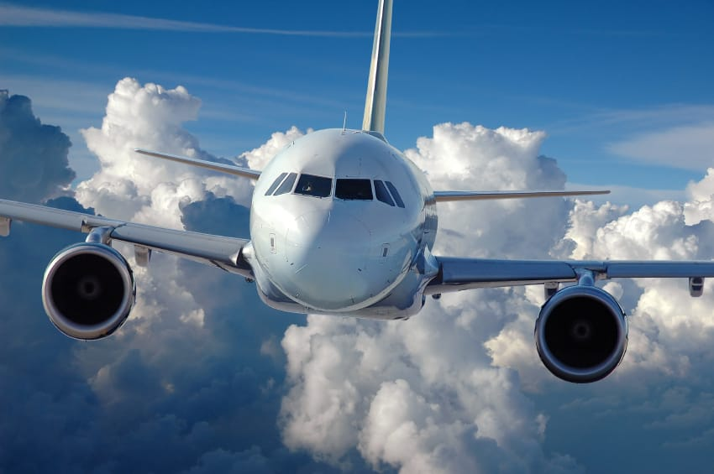
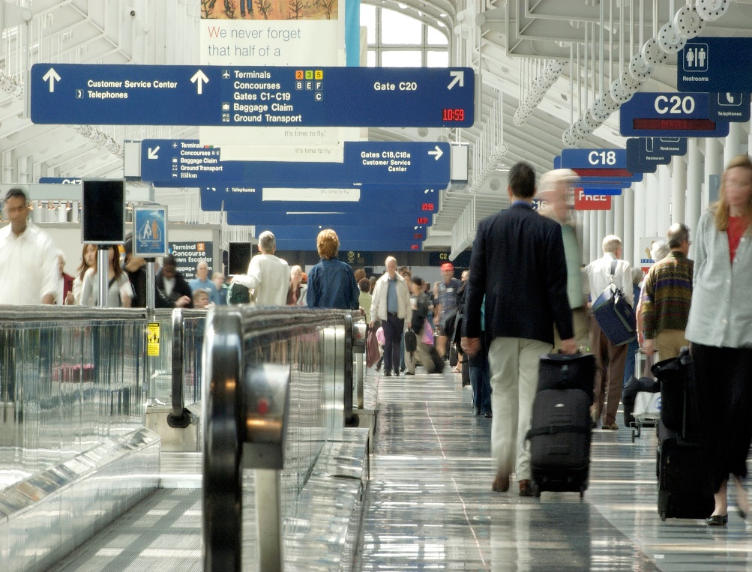
Airline Data Presentation
Oliver Baker
Hatch Data Academy
20/12/2023

Slide 2
Table of Contents
Objectives,
Data Dictionary,
Surface Exploration of Dataset: Understanding The Terrain,
Hypotheses,
Hypothesis testing & interpretation,
Deeper Exploration

Slide 3
Objectives
What have we got here?
We are exploring and analysing a dataset concerning the flight experiences and satisfaction ratings of 128,880 airline customers.
Why are we looking at it?
We are interested to explore the demographics of our customer base, find out how satisfied our sample is, which services are most significant to our customer satisfaction, where we are doing well, and where we should focus for improvement.
What’s the idea?
To make recommendations for where the airline should focus its resources to further boost customer satisfaction.

Slide 4
Data Dictionary: what is what?
Passenger Variables | Travel Variables | Airport Variables
ID: unique identifier for each passenger. Gender: gender of passenger (male/female). Age: age of passenger (years). Customer Type: is the customer returning or a first-timer? Type of Travel: purpose of travel, business or personal. Class: business, economy, or economy plus+ while on plane. | Flight Distance: how far this passenger flew in miles. Short haul = <1,000 Medium haul = 1,001-3,499 Long haul = 3500+ Arrival Delay: difference between scheduled arrival and actual arrival time in minutes. Departure Delay: difference between scheduled departure and actual departure in minutes. Arrival & Departure Convenience: Passenger satisfaction with arrival and departure delays, scaled 0-5. | Check–in service: Customer rating from 0 to 5 in their satisfaction with check-in processes. Gate Location: customer satisfaction with ease of locating gate, 0-5 scale. Baggage Handling: customer satisfaction with quality of luggage handling, 0-5 scale.
This table contains all the dataset variables that would be outside the airline’s control, affected by external forces and influences.
We will still discuss and examine these when they are relevant, but this presentation will focus mainly on variables that are within the airline’s control as this will likely be a more productive use of this data to identify trends and offer recommendations.
Now let’s identify the airline variables on the next slide…

Slide 5
Data Dictionary: what is what?
Pre-flight Variables | In-flight Variables | Composite Variables
Ease of online booking: customer rating in their satisfaction with online flight booking Online boarding: customer rating for their satisfaction with online boarding | On-board service: customer rating of their satisfaction with on-board services. Seat Comfort: customer rating of their satisfaction with aircraft seating. Leg room service: Customer rating of their satisfaction with leg room in the seating. Cleanliness: Customer rating of their satisfaction with the cleanliness of the aircraft. Food & drink: Customer rating of their satisfaction with in-flight meals and refreshments. In-flight service: Customer rating of satisfaction with services provided by airline staff during flight. In-flight wifi service: Customer rating of satisfaction with aircraft WiFi service. In-flight entertainment: Customer rating of satisfaction with in-flight entertainment media. | Satisfaction – Customer’s overall self-reported satisfaction rating for their entire experience. Mean In-flight Satisfaction: mean average of all in-flight satisfaction scores, calculated to represent satisfaction with flight service. Airport Satisfaction: mean average of satisfaction scores with airport services. Overall Satisfaction: mean average satisfaction calculated from all satisfaction scores.
All satisfaction scores operate on a scale of 0-5 except for ‘satisfaction’ which was dichotomous between ‘satisfied’ or ‘neutral/dissatisfied.’

Slide 6
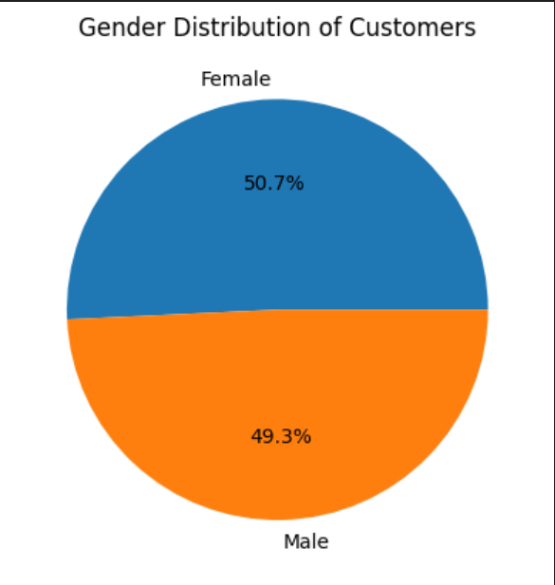
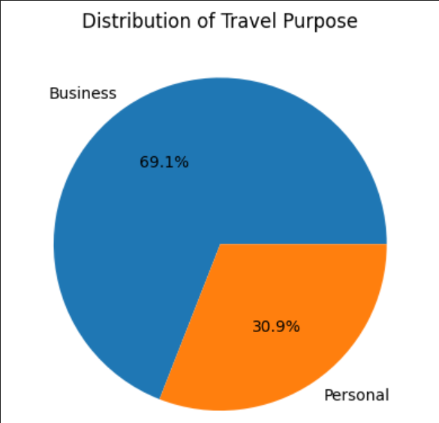
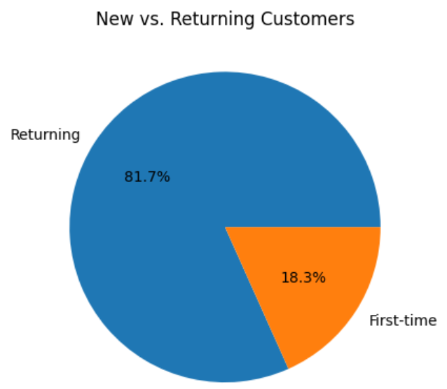
Understanding Our Sample
Customers are split evenly on gender.
A majority of our customers travel with us for business purposes (e.g. work)
A large majority of our customers are returning customers rather than first-timers.
The fact that such a large proportion of our customers are returning clients is usually a good sign because customer loyalty tends to indicate consistent satisfaction with services rendered.
Additionally, the fact that a majority of our customers travel for business gives us an idea of what features are likely to be important for them to feel satisfied with their experience rather than dissatisfied.

Slide 7
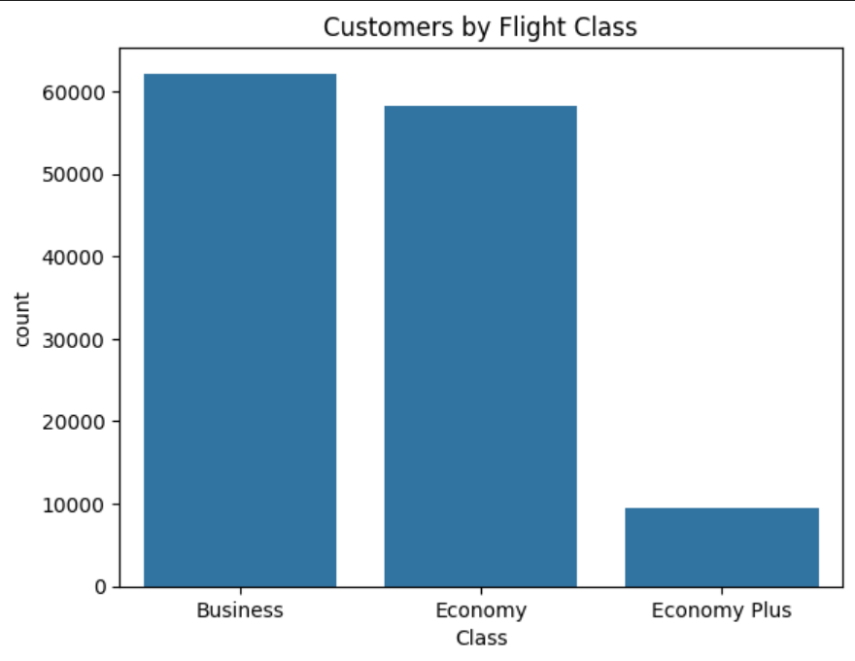
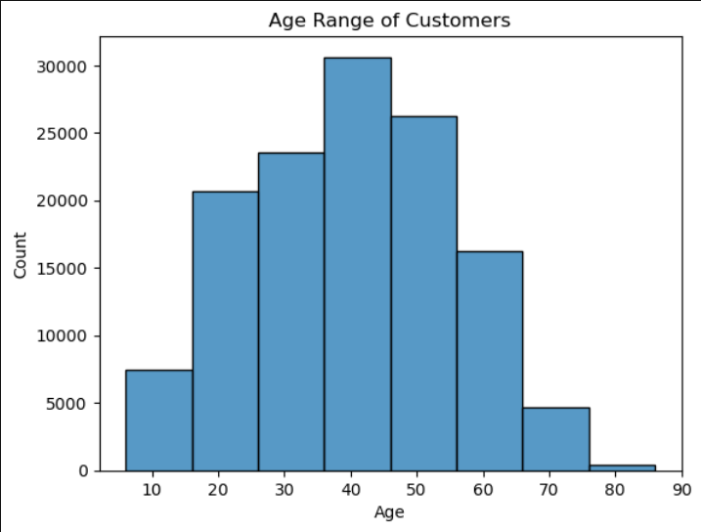
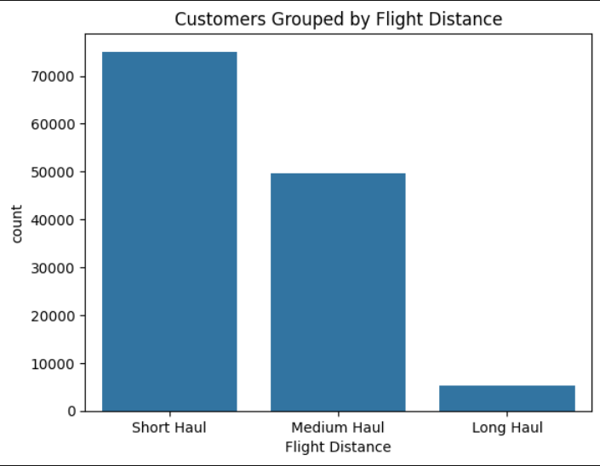
Understanding Our Sample
48%
45%
57%
38%
7%
5%
Large age range of customers (7-85 years) but the majority are between 20-60.
Most of our customers travel on short haul and medium-haul flights.
There’s a near-even split in Business & Economy class flyers, comparatively much smaller number of Economy+ flyers.
Most of our customers are short or medium haul flyers which may be positive or negative, depending on whether our aircraft fleet is designed with profitability in mind for short/medium flights which depends on its composition (e.g larger airliners are much more cost-efficient for long-haul journeys than short-haul)
The diverse age range of our customers also means we have to be prepared to cater to a broad spectrum of differing wants and needs, meaning we may need to consider how we can adapt in-flight services to suit each age group.

Slide 8
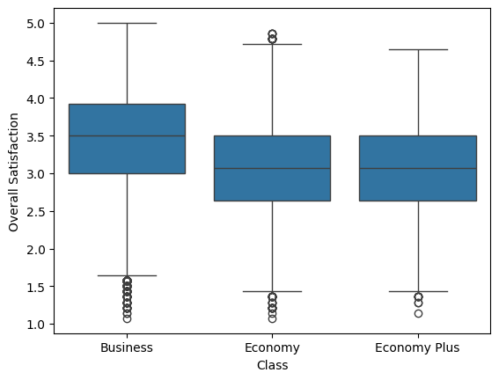
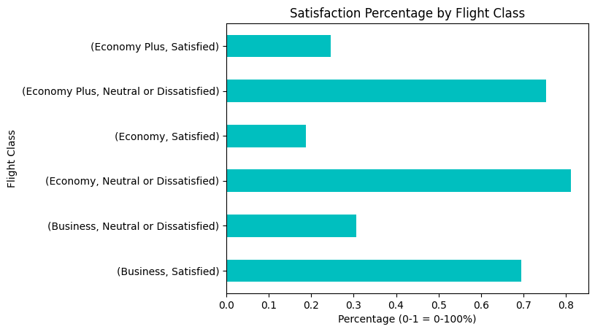
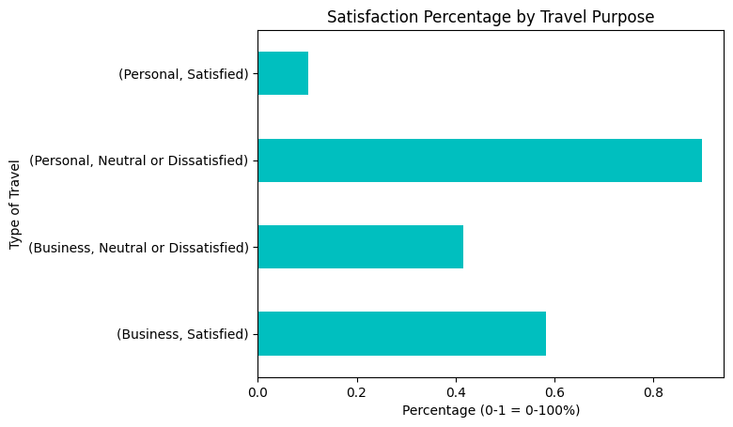
Who’s Satisfied?
69% of Business-class flyers report ‘Satisfied’ with overall experience, but much fewer ‘Satisfied’ reports from Economy and Economy+ flyers.
Business-class flyers report the highest satisfaction while Economy and Economy+ flyers have lower average overall satisfaction score.
Personal flyers were also the most likely to be dissatisfied, whereas Business flyers were more evenly divided.
Why is this? Which aspects of the journey are most significant to customer satisfaction? Where do we begin to look?
Fortunately I had a few ideas based on what we’ve seen already!

Slide 9
Hypotheses to Consider
What are hypotheses?
In a nutshell, a hypothesis is an educated guess on something we think will be true if we check it with observation or data or both.
Why do we test hypotheses?
Hypothesis testing permits us to objectively determine whether those guesses are accurate or not and it may also reveal new information or patterns that were not considered previously. This is why they form the foundational framework for any kind of research work.
What about in this context?
The airline wants us to identify what’s working well to promote customer satisfaction across the different age ranges, flight classes, travel purposes, etc. to better understand what’s important to our customer base because more satisfied customers will travel with us more often and may attract their friends and relatives to travel with us too. Producing and testing hypotheses about what we might observe when testing satisfaction data enables us to do this in a logical and systematic manner.
For example, if we think satisfaction with in-flight Wi-Fi will differ based on customer age group, we are able to hypothesise this and then test it using data analysis. Let’s start by examining this example on the next slide…

Slide 10
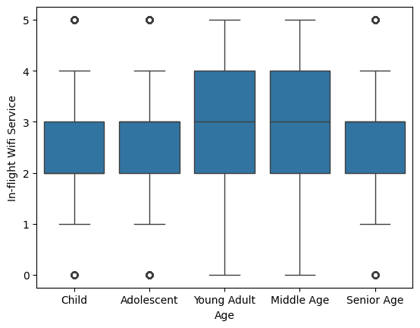
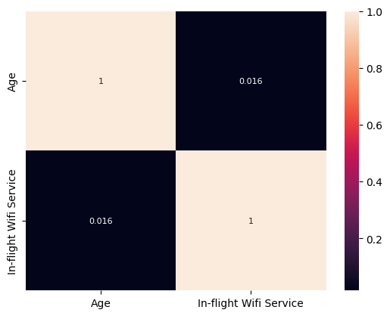
Null hypothesis (H0): “satisfaction scores for in-flight WiFi will not differ across age groups.”
Interesting to note that satisfaction scores with Wi-Fi service on our airliners does not appear to differ significantly between age groups, though young and middle aged adults do have a larger variance around the mean satisfaction score.
We can confirm this using a heatmap that shows us the correlation between age and Wi-Fi satisfaction is negligible, at only 0.016.
We therefore accept the null hypothesis as stated in the title. But what about web-based services overall?

Slide 11
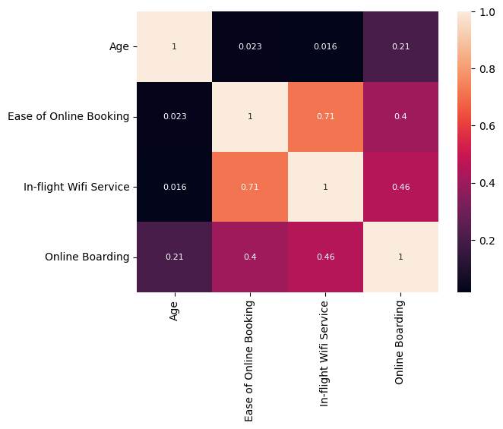
Null hypothesis (H0): “satisfaction scores for online services will not differ across age groups.”
Looking at the heatmap, we see that age only has a weak positive correlation (0.21) with satisfaction score for online booking. The other two web-based services were again negligible.
Therefore we again accept the null hypothesis.
This is interesting because many would assume that older passengers would be less satisfied with web-based services due to generational differences in tech usage.
The takeaway from this finding would be that other factors are influencing passenger satisfaction and we should explore elsewhere for now!

Slide 12
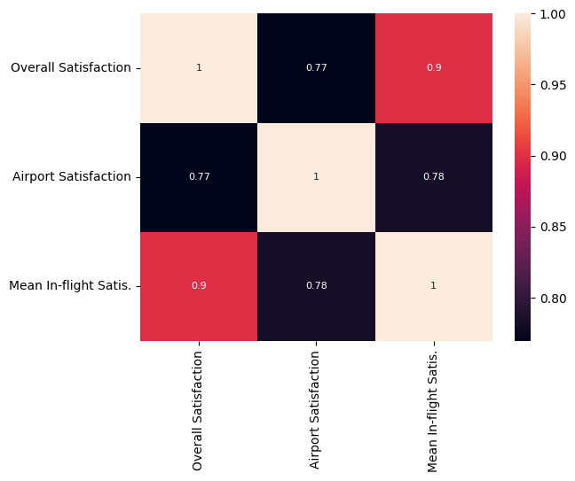
H0: “Airline variables will not differ to airport variables in their correlation with overall satisfaction.”
Airport and in-flight variables both have a strong positive correlation with overall customer satisfaction, which should be expected.
However, in-flight satisfaction has the stronger correlation which means the in-flight services matter more to customers than the airport services, though the airport services do remain a significant influencer.
We can also note a strong positive correlation between airport satisfaction and in-flight satisfaction: perhaps a bad start spoils the entire journey or a good start make the journey more positive!
Okay, so let’s see how airport variables correlate with overall satisfaction…

Slide 13
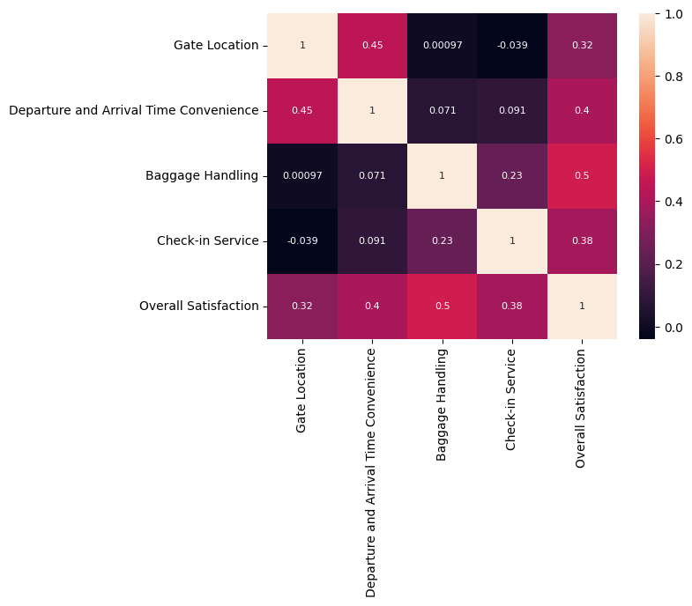
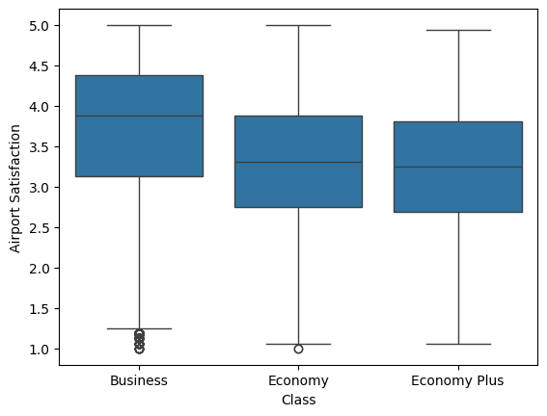
Airport Variables and Overall Satisfaction
Arrival/delay convenience, gate location, baggage handling, and check-in service all have noteworthy positive correlations with overall satisfaction.
Airport satisfaction is slightly higher on average with Business flyers than Economy or Economy+
This does indeed suggest that a positive experience using various airport services can influence one’s satisfaction with the overall experience. Important to know because airport services are not under the airline’s control!

Slide 14
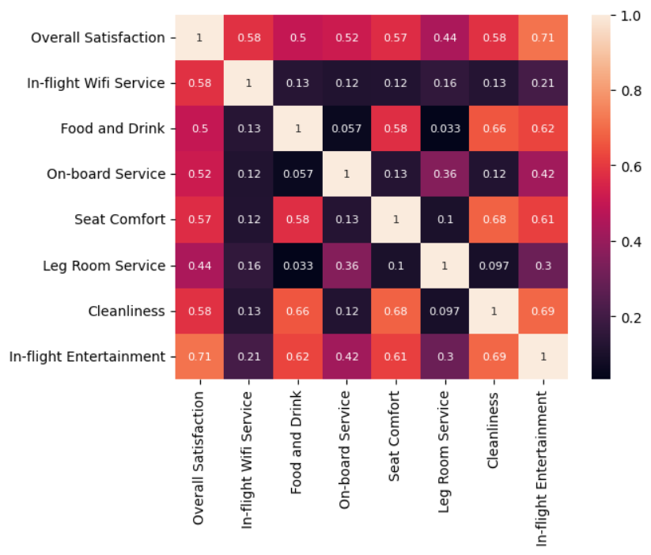
Which in-flight variables are most highly correlated with satisfaction?
All of the in-flight satisfaction variables have a positive correlation with overall satisfaction, meaning every satisfaction measure has a significant impact on overall satisfaction.
Wi-Fi and leg room had the lowest correlation coefficient of the bunch, but not weak!
In-flight services ranked by impact on customer satisfaction are:
Entertainment,
Seat comfort,
Wi-Fi,
Cleanliness,
Staff service,
Food and drink,
Leg room.

Slide 15
How do these variables affect each other?
We can also note that several of the in-flight variables have strong correlations with each other:
Food & Drink is influenced by cleanliness and seat comfort.
Staff service is influenced by entertainment and leg room.
Seat comfort is influenced by entertainment, cleanliness, and food & drink.
Leg room service is influenced by entertainment and staff service.
Cleanliness is influenced by entertainment, seat comfort, and food & drink.
Entertainment is influenced by cleanliness, seat comfort, staff service, and food & drink.
This identifies where interactions occur between flight variables and helps us understand how they affect each other.

Slide 16
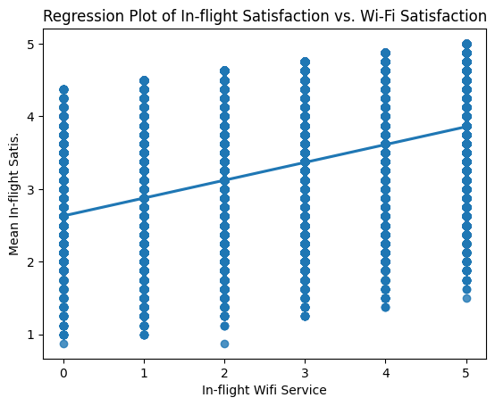
Which in-flight variables performed the best?
* | In-flight WiFi | Food and Drink | On-board Service | Seat Comfort | Leg Room Service | Cleanliness | In-flight Entertainment
Mean | 2.73 | 3.20 | 3.38 | 3.44 | 3.35 | 3.29 | 3.36
St.deviation | 1.33 | 1.33 | 1.29 | 1.32 | 1.32 | 1.31 | 1.33
Median | 3 | 3 | 4 | 4 | 4 | 3 | 4
Mode | 2 | 4 | 4 | 4 | 4 | 4 | 4
*- Score range for all variables was 0-5.
Overall all variables performed reasonably well, but inflight Wi-Fi satisfaction was noticeably lower.
In order, performance ranking is:
Seat Comfort,
On-board Service,
Leg Room Service,
Entertainment,
Cleanliness,
Food & Drink,
In-flight WiFi.
Suggestion: consider new ISP!

Slide 17
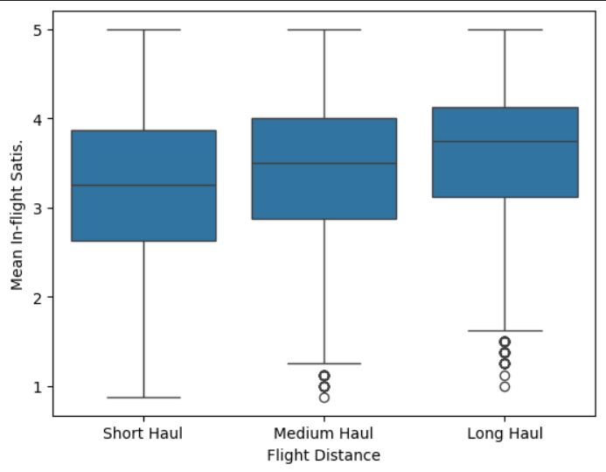

H0: “Flight Distance will not have a strong correlation with in-flight satisfaction.”
Box plot data suggest a moderate increase in in-flight satisfaction as flight distance increases, which is confirmed by the heatmap that reports a weak positive correlation of 0.15 between the two. H0 accepted.
The implication is that passengers who fly further with us experience our in-flight services for longer and report greater satisfaction because of that. Positive indicator!
Which flight class is doing the furthest flying?

Slide 18
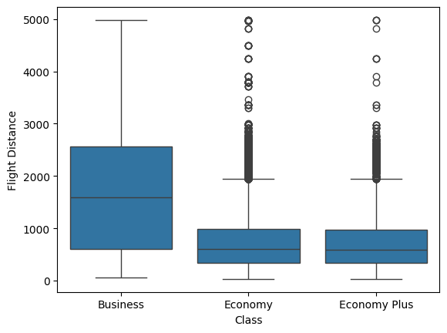
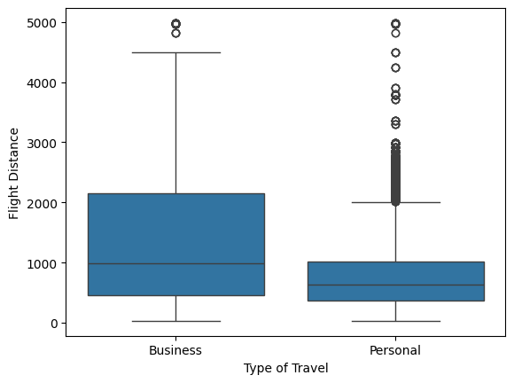
Flight Distance vs. Flight Class vs. Travel Purpose
Business flyers tend to travel the furthest whereas Economy and Economy+ tend towards short and medium-haul flights, albeit with multiple outliers.
This also matches with travel type, as those who travel for business tend to fly further than those travelling for personal reasons.
Can this partially explain the sharp difference in satisfaction ratings between Business and Economy/Economy+? The vast majority of our customers were short and medium-haul flyers so perhaps not!

Slide 19
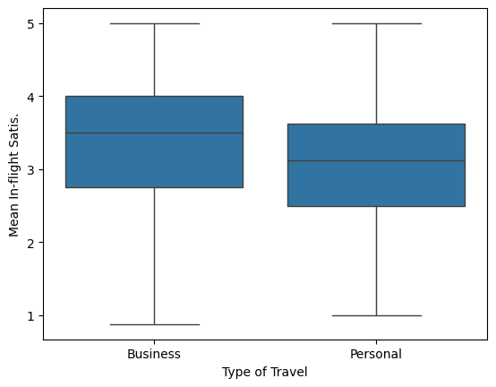
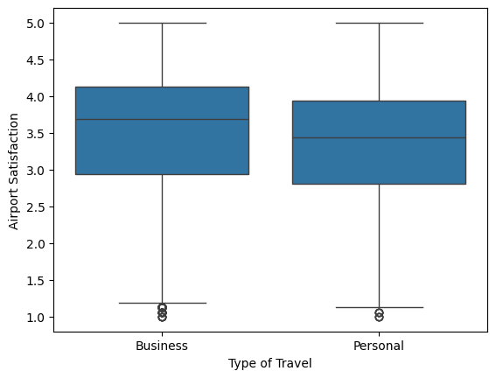
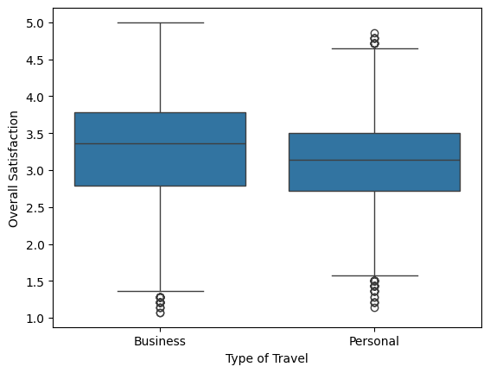
H0: “Business travellers will not report greater satisfaction than personal travellers”
 | Mean | Median
Business | 3.38 | 3.5
Personal | 3.11 | 3.13
 | Mean | Median
Business | 3.52 | 3.68
Personal | 3.34 | 3.44
 | Mean | Median
Business | 3.30 | 3.35
Personal | 3.12 | 3.14
Business travellers did show a small increase in average satisfaction across all three dimensions shown here, but the difference is too small to explain the sharp difference in self-reported satisfaction rating that we discussed earlier in ‘Understanding our Customers’ (i.e. Satisfied vs. Neutral/Dissatisfied when customers were asked to describe their own satisfaction)
With this in mind, what else might be causing the difference in satisfaction between Personal and Business travellers?

Slide 20
H0: “Business travellers will not report greater satisfaction than personal travellers”
See the inconsistency?
Practical tip from psychometrics: self-report measures rely on participants being able to introspect well and give an accurate summary of how they feel about an experience. Not everyone is good at this!
Maybe these findings indicate an issue with the construct validity of my composite variables, or with how the airline survey measures customer satisfaction?

Slide 21
Executive Summary
Key takeaways for airline to action:
Send technical support to troubleshoot in-flight Wi-Fi,
Review/redesign customer satisfaction survey,
Discuss passenger feedback with airport due to airport variable significance,
Be pleased with overall satisfaction scores!

